Slide 1
PRDA – 05 Customer Data Analysis
Istanbul | 2021-2023 |
PTID-CDA-JUN-25-592
AGNEL SUMITHA A

Slide 2




Methodology
Data Cleaning
The date column with incorrect data type was converted to the appropriate data type.
Used Power Query to create Fact and Dimension tables, connected through
many-to-one relationships. DAX functions helped build key measures like Revenue, Average Transaction, and Customer Count for deeper insights.
Data Modelling
Data covered Jan–Mar 2023 only, with complete entries, valid demographics, and values in Turkish Lira.
Data Assumption
Explored structure and patterns using Power BI’s Data View, Query Editor, and visual summaries to guide segmentation.
Data Exploration

Slide 3

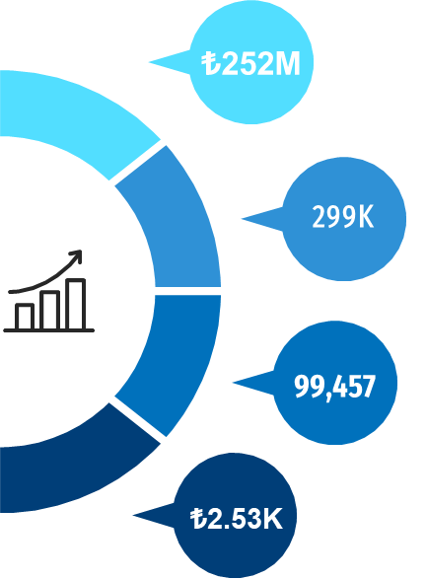
Business Performance Overview
Reflects strong sales performance and consistent customer demand across mall outlets.
Revenue
Quantity
High product movement indicates healthy inventory turnover and purchase volume.
A solid customer base, showing strong footfall and brand engagement.
Customers
Suggests high spending per visit, pointing to quality customers and upsell potential.
Average Transaction

Slide 4
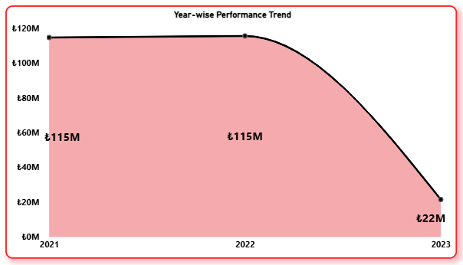
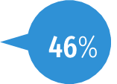
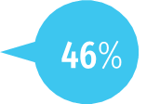
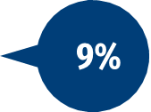
Year – Wise Performance
2021
2022
2023
Strong growth in 2021 & 2022, with a sharp dip in 2023 (₺22M) due to partial data (Jan–Mar).

Slide 5

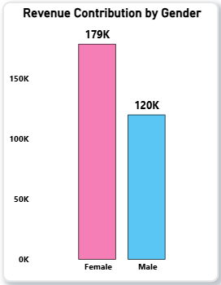
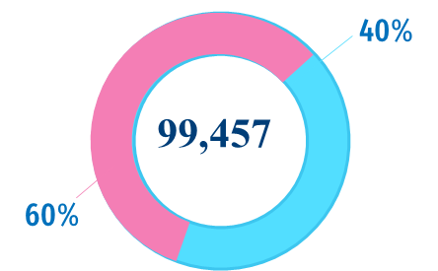
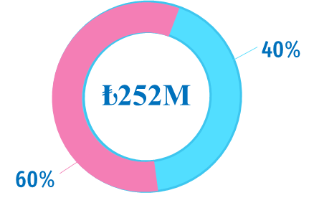
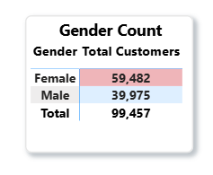
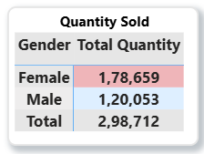
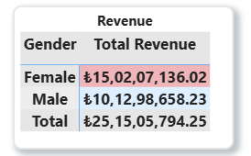
Who Leads the Shopping? A Gender Comparison
Count
Quantity Sold
Revenue

Slide 6
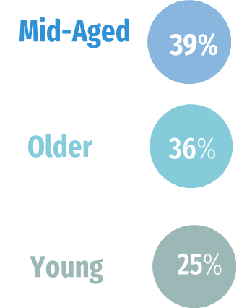



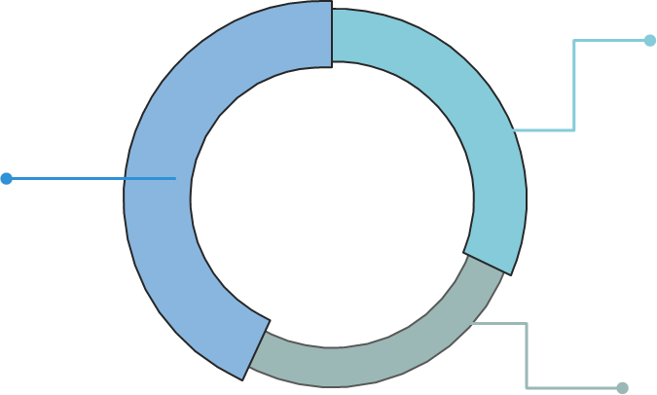
Who Shops the Most? An Age-Wise Comparison
Mid-aged customers (39%) drive the highest revenue (₺97M) and lead in quantity sold (115K units).
Older customers (36%) remain strong contributors with ₺91M in revenue, and quantity sold(109k) units indicating strong and consistent purchasing power
Young shoppers (25%) show lower engagement, with only ₺63M revenue and 75K quantity sold.
A clear correlation exists between age and purchase volume/value — older age groups drive the majority of sales.
Businesses should prioritize mid-aged and older demographics while exploring ways to better engage younger consumers.
Count
109k
₺ 91 M
Older
Older
115k
Quantity Sold
₺ 97 M
Revenue
Mid-Aged
Mid-Aged
₺ 63M
75k
Young
Young

Slide 7
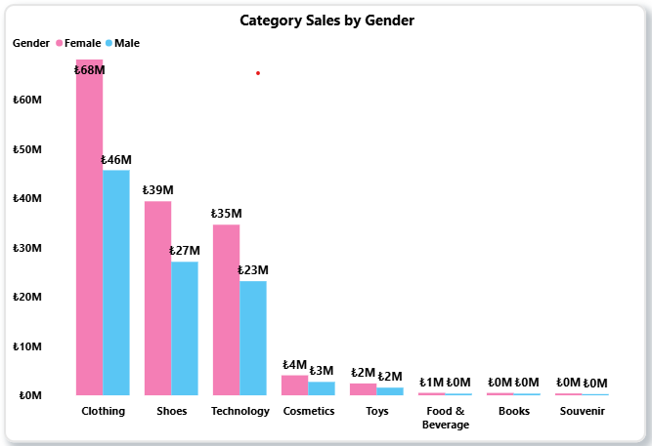
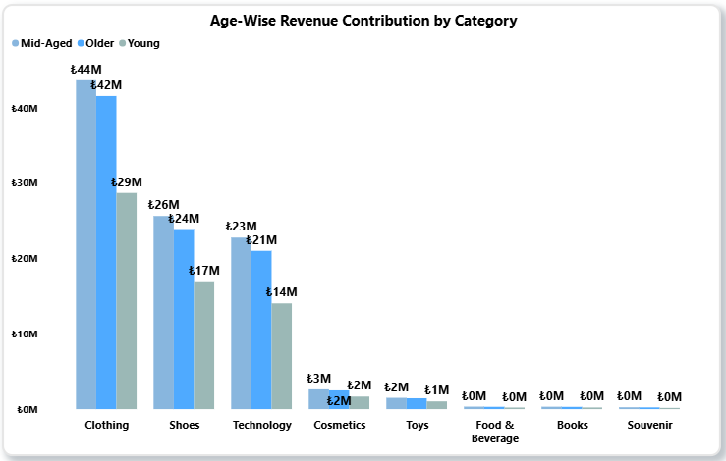
Category-Wise Revenue Comparison by Gender & Age Group
Clothing leads revenue across all genders and age groups.
Females outspend males in top categories like Clothing, Shoes, and Technology.
Mid-aged shoppers are the biggest spenders, especially on Clothing and Shoes.
Younger and older groups contribute less, indicating lower purchasing power.
Cosmetics, Toys, and Souvenirs show limited demographic variation.
Books and Food & Beverage generate the lowest revenue across all segments.

Slide 8
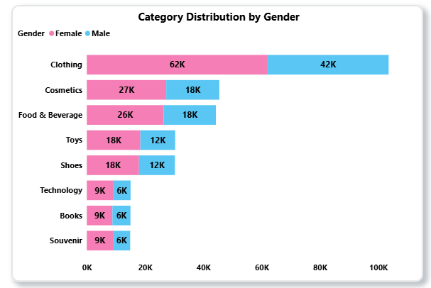
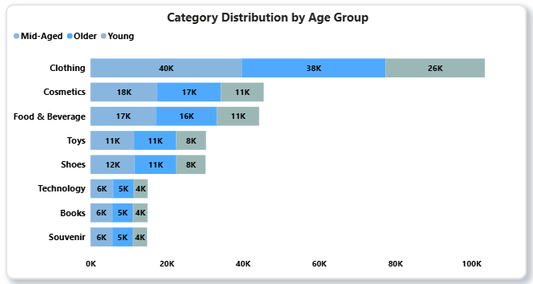
Who Buys What?
Category Preferences Across Segments
Women lead in high-engagement categories like Clothing (62K) and Cosmetics (27K).
Men also show notable interest in Cosmetics (18K) — higher than their preference for Books (12K).
Technology, Toys, and Shoes are relatively more preferred by men.
Souvenirs show a balanced split between both genders.
Mid-aged customers are the top spenders and lead most product categories.
Older buyers show surprisingly high engagement, especially in Clothing(38K) and Cosmetics(17K).
Young shoppers focus on Clothing, Cosmetics, and Shoes and Toys, suggesting a trend-driven purchase style.

Slide 9
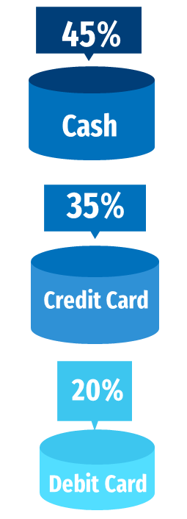
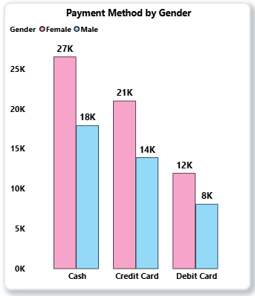
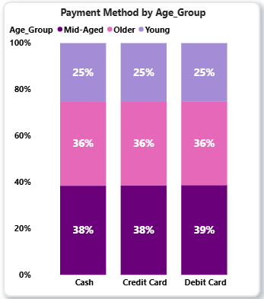
Cash or Card? Unpacking Payment Behaviors
Cash dominates with 45% of all transactions, especially among female and mid-aged customers.
Cards (Credit & Debit) make up 55%, with higher usage by male and young shoppers.
Gender and age influence payment preferences, showing a clear divide in digital vs. traditional behavior.

Slide 10

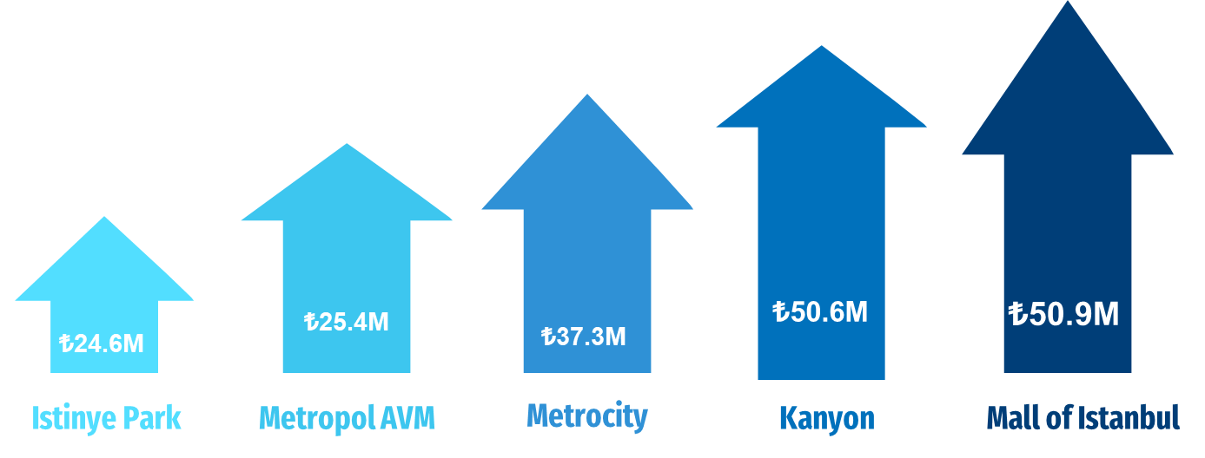
Top 5 Malls

Slide 11
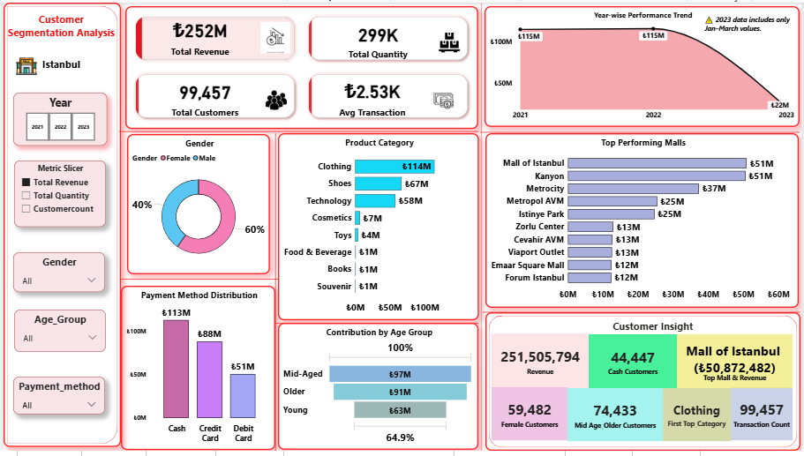

Slide 12
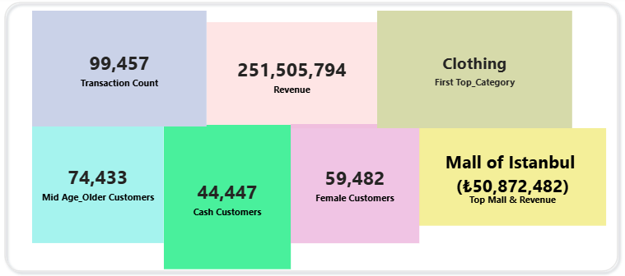






Customer Insight using a 5D framework – Volume, Value, Variety, Behavior, and Loyalty
Volume Indicator
Variety Indicator
Value Indicator
₺
Volume- Demographic split
Behavior – Payment Preference
Volume- Gender Split
Loyalty- Highest Contributing Mall

Slide 13
Summary
Core Customer Segments
Mid-aged and female customers are the top spenders.
Male shoppers show lower activity — opportunity for targeted engagement.
Category Trends
Clothing, Shoes, and Tech lead in sales.
Books, Toys, Souvenirs, and Cosmetics show niche appeal or low visibility.
Payment Patterns
Cash is still dominant, followed by credit cards.
Digital wallets are rising, especially among younger customers.
Demographic Engagement
Mid-aged buyers drive the most revenue.
Younger and older groups show lower interest — possibly due to product fit or low visibility.
Mall Performance Drivers
Top malls benefit from strong category mix, targeted campaigns, and favorable locations.

Slide 14

Recommendation Scale What’s Working (High-Performers)
🎯 Focus on High-Spending Segments Target mid-aged female shoppers with loyalty offers and campaigns.
👗 Boost Best-Selling Categories Prioritize inventory for Clothing, Shoes, and Tech — top revenue drivers.
🏬 Replicate Winning Mall Strategies Apply successful practices from Mall of Istanbul to weaker malls.
📅 Leverage Seasonal Trends Align stock and promotions with peak shopping months to avoid overstocking.
💳 Encourage Digital Payments Offer cashback or rewards to shift from cash to wallets/cards.

Slide 15

Strategic Recommendations Fix What’s Lagging (Low-Performers)
👦👵 Engage Underrepresented Groups Run targeted campaigns for young males and senior shoppers.
📚 Revamp Low-Revenue Categories Improve visibility and bundling of Books, Toys, Cosmetics, and Souvenirs.
🏢 Reposition Underperforming Malls Add pop-ups, events, and brand variety to attract footfall.
Improve Accessibility & Experience Enhance layout, entertainment options, or local brand partnerships in low-traffic malls.
📲 Push Digital Enablement Promote QR-based payments and loyalty apps, especially among younger shoppers.

Slide 16
Thank You

